Slide 1
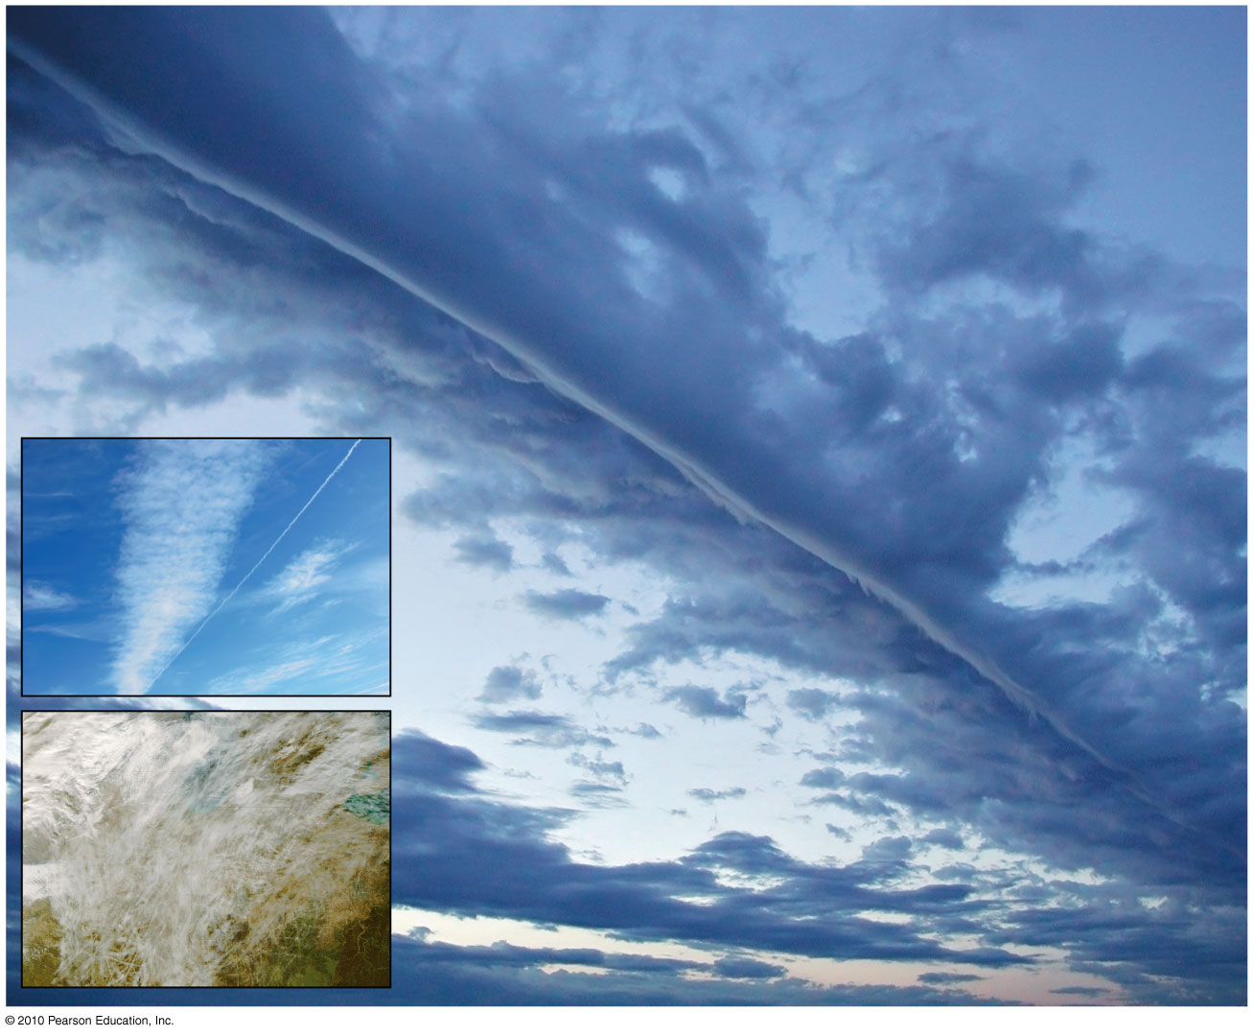
CHAPTER 3
ATMOSPHERIC ENERGY &
GLOBAL TEMPERATURES

Slide 2
Atmospheric Energy and Global Temperatures
Quick Preview:
Energy Essentials
Energy at Earth’s Surface
Temperature Concepts and Controls
Earth’s Temperature Patterns
The Urban Environment
Notes:
No temperature concepts & controls

Slide 3
Energy Essentials
Energy Pathways and Principles
Insolation as it passes through the atmosphere to Earth’s surface – how energy is absorbed and redirected along various pathways in the troposphere
Earth- Atmosphere System which shows the energy gained and lost by Earth’s surface
Transmission – passage of shortwave and longwave radiation through the atmosphere or water:
Shortwave radiation ~ inputs ~ (ultraviolet light, visible light and near infrared wavelengths)
Longwave radiation ~ outputs ~ (thermal infrared)

Slide 4
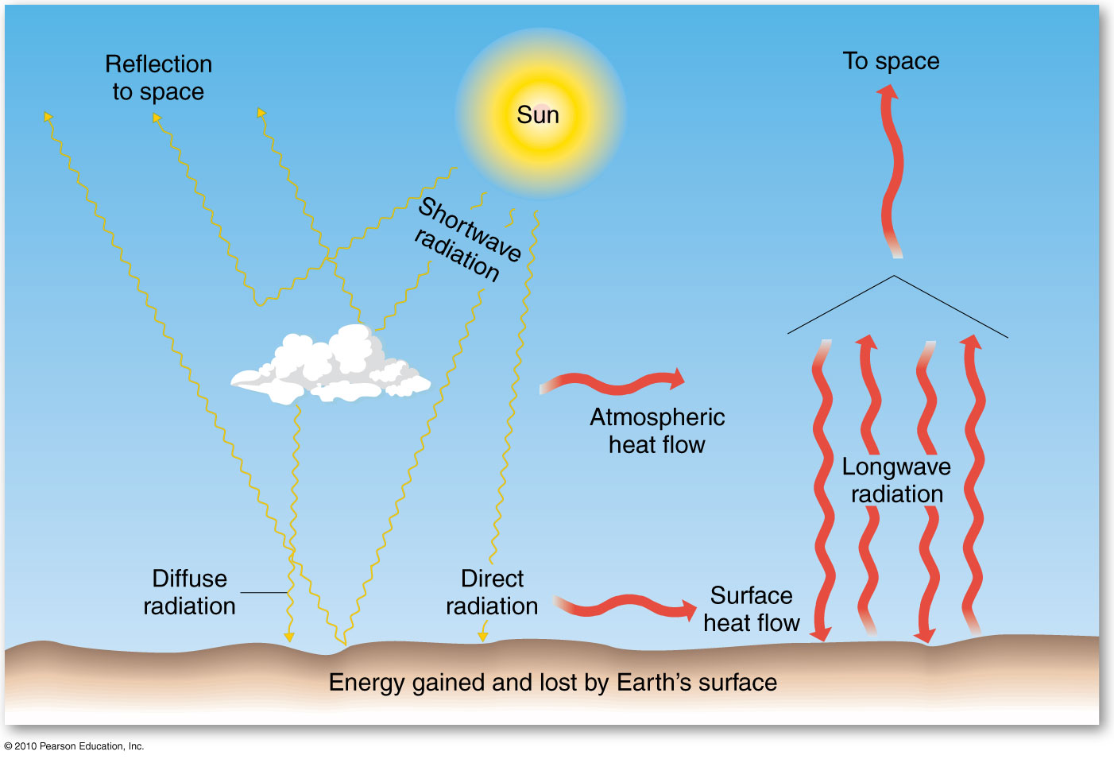
Energy Pathways
Figure 3.1
Christopherson, Elemental Geosystems, Sixth Edition
Copyright © 2010 Pearson Education, Inc.
Notes:
Reflected or diffused radiation absorbtion
Ice reflects longwave is what warms up air. Hot to cold air flow

Slide 5
Energy Pathways and Principles
Insolation Input
Single energy input that drives the earth-atmosphere system
Scattering (Diffuse Radiation)
Gas molecules in the atmosphere redirect radiation; changing the direction of light’s movement but not the wavelength – represents 7% of Earth’s reflectivity
Dust particles, pollutants, ice, cloud droplets and water vapor causes further scattering
Air pollution – smog & haze
Refraction
Insolation entering the atmosphere is moving from empty space into atmospheric gases or from air to water.
Transition subjects the insolation to a change of speed, which also shifts its direction, bending light similar to a prism

Slide 6
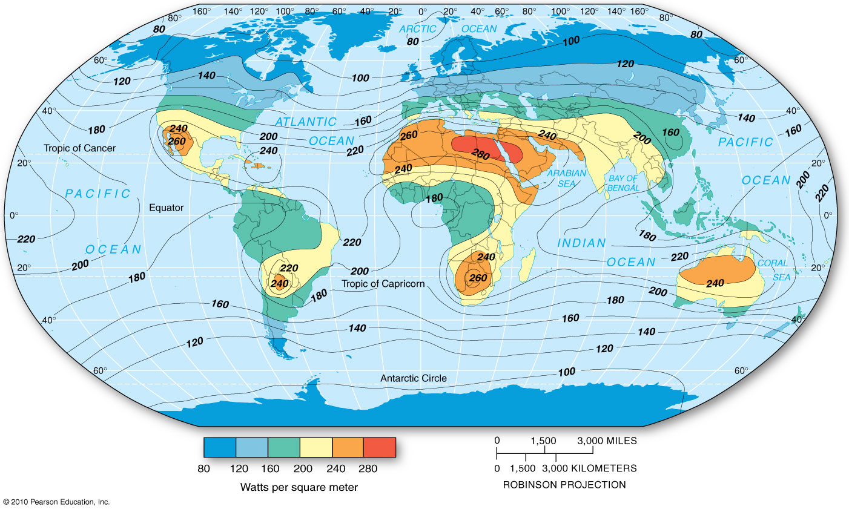
Insolation at Earth’s Surface
Figure 3.2
Christopherson, Elemental Geosystems, Sixth Edition
Copyright © 2010 Pearson Education, Inc.
Notes:
Lack of vegetation and lack of clouds is why deserts get so hot (insolation)

Slide 7
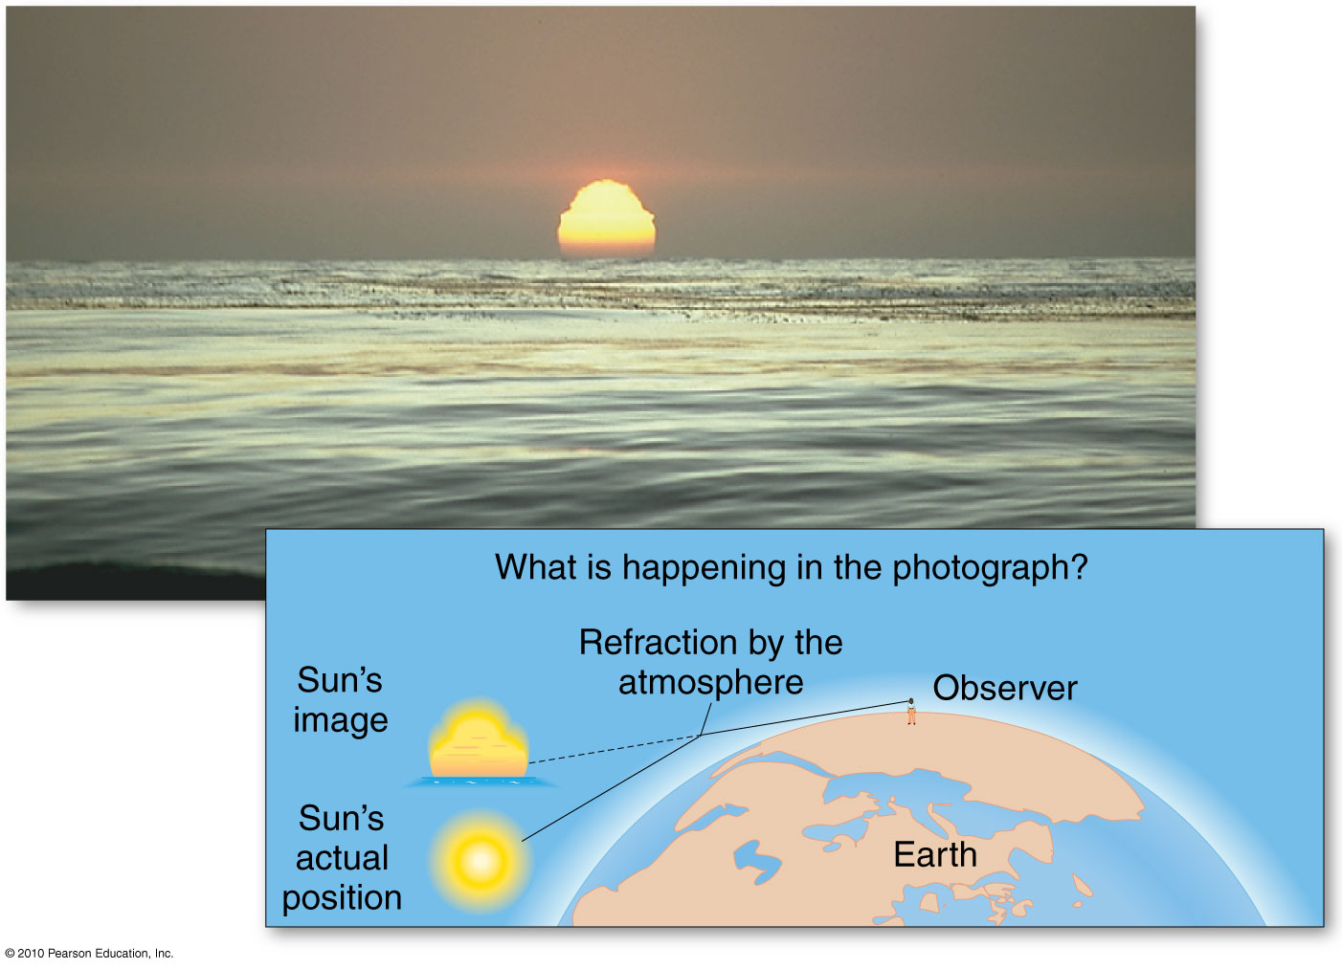
Sun Refraction
Figure 3.4
Christopherson, Elemental Geosystems, Sixth Edition
Copyright © 2010 Pearson Education, Inc.
Notes:
4 minutes extra a day, atmosphere

Slide 8
Energy Pathways & Principles
Albedo and Reflection
Arriving insolation that bounces back into space
Clouds and the Atmosphere’s Albedo
Cloud-albedo forcing; cloud-albedo greenhouse forcing
Absorption
Assimilation of radiation and its conversion from one form to another
Absorbed and converted to longwave radiation
Absorbed by land, water, atmospheric gases, dust, clouds and and ozone layer
Conduction, Convection, and Advection
Form of transferring heat energy in a system
Notes:
Clouds reflect (more clouds more reflection) and diffuse
More reflection = cooler air unless greenhouse pollution ozone absorbs 03 diffuses radiation

Slide 9
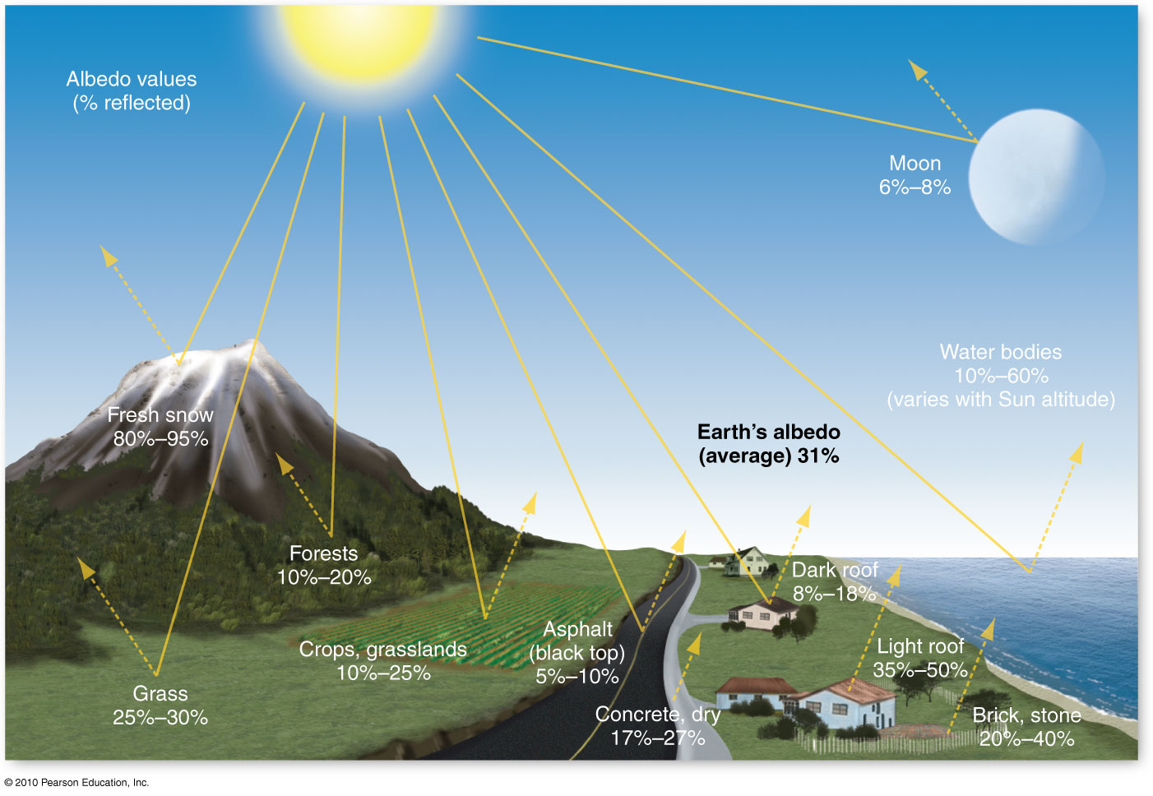
Albedo- the percentage of insolation that is reflected
Figure 3.5
Christopherson, Elemental Geosystems, Sixth Edition
Copyright © 2010 Pearson Education, Inc.

Slide 10
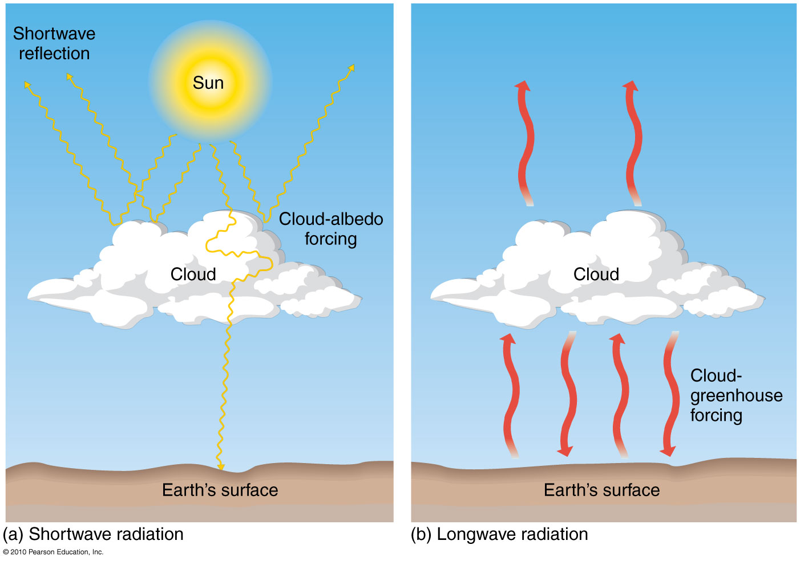
Clouds and Albedo: Effects of Clouds on shortwave & longwave radiation
Figure 3.6
Christopherson, Elemental Geosystems, Sixth Edition
Copyright © 2010 Pearson Education, Inc.

Slide 11
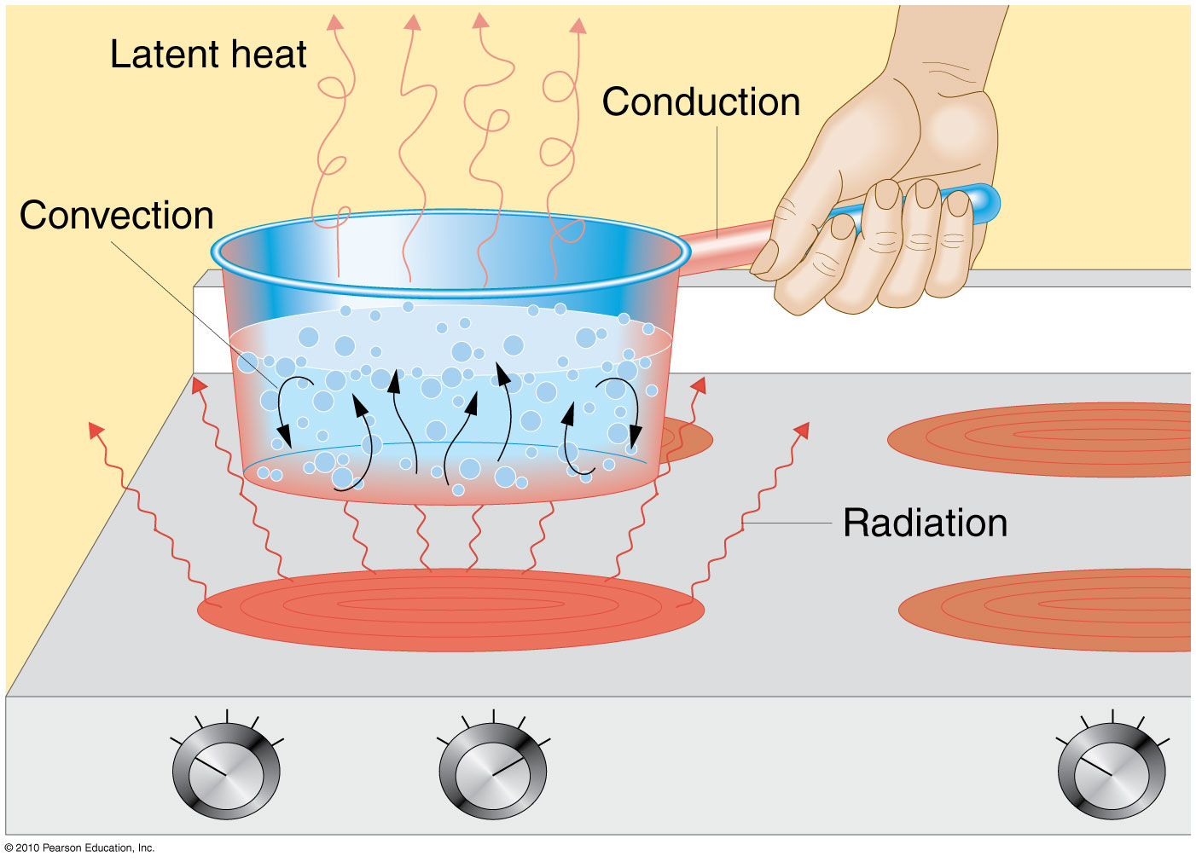
Heat energy transfer processes: Conduction, Convection & Advection
Figure 3.7
Notes:
Convection is up-down heat transfer
Conduction is heat of system
Advection is horizontal heat transfer radiation is transfer of heat

Slide 12
The greenhouse effect & atmospheric warming
Long wave radiation absorbed by CO_{2,}water vapor, methane, CFCs and other gases, and then re-radiated back to Earth; delaying heat loss to space
Warms the lower atmosphere – green house effect
Increasing CO₂ concentration is causing more longwave radiation absorption in the lower atmosphere – causing a warming trend

Slide 13
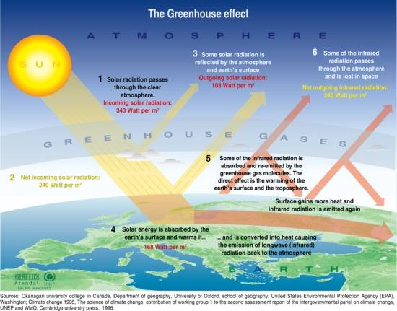

Slide 14
Clouds & earth’s “Greenhouse”
Cloud
Type, height & thickness
Percentage of cloud cover
Cloud – greenhouse forcing
Caused by high clouds (ice-crystal cirrus)
Cloud - albedo forcing
Produced by lower, thicker clouds (stratus)
Jet contrails – false cirrus clouds
Diurnal temperature range
Difference between daytime maximum and nighttime minimum temperatures

Slide 15
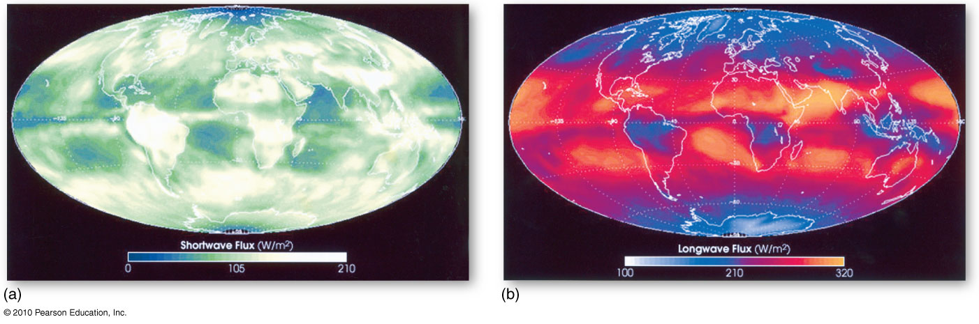
Shortwave and Longwave Energy
Earth’s Albedo:
Outgoing shortwave energy flux
reflected from clouds, land & water
Longwave energy flux emitted by
surfaces back to space
Images show Earth’s radiation budget components
CERES sensors aboard the Terra made these images in March 2000
Figure 3.9

Slide 16
Earth – Atmosphere Energy Balance
Of 100% of solar energy arriving:
31% accounts for albedo reflectivity
69% net outgoing longwave radiation
21% atmosphere heating
45% surface heating
3% ozone emission
Energy budget by latitude
Imbalance of net radiation
Tropical surpluses – more energy is received than is lost
Polar deficits – more energy is lost than gained

Slide 17
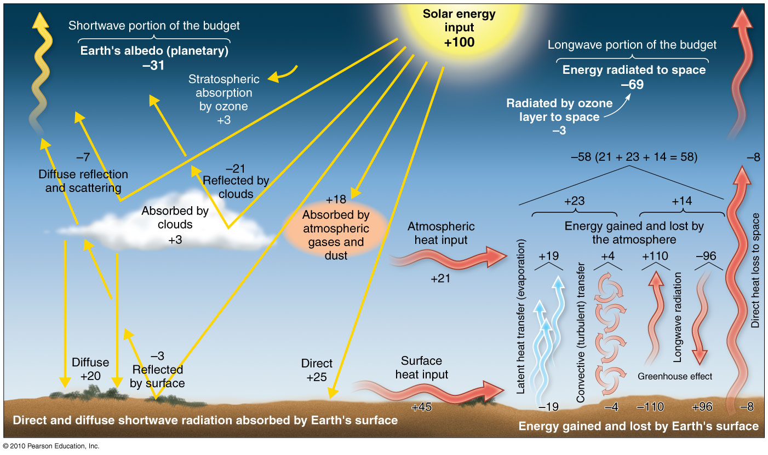
Earth–Atmosphere Radiation Balance
Figure 3.10
Christopherson, Elemental Geosystems, Sixth Edition
Copyright © 2010 Pearson Education, Inc.

Slide 18
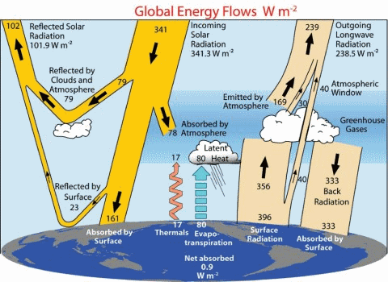
Kiehl-Trenberth Energy Balance diagram

Slide 19
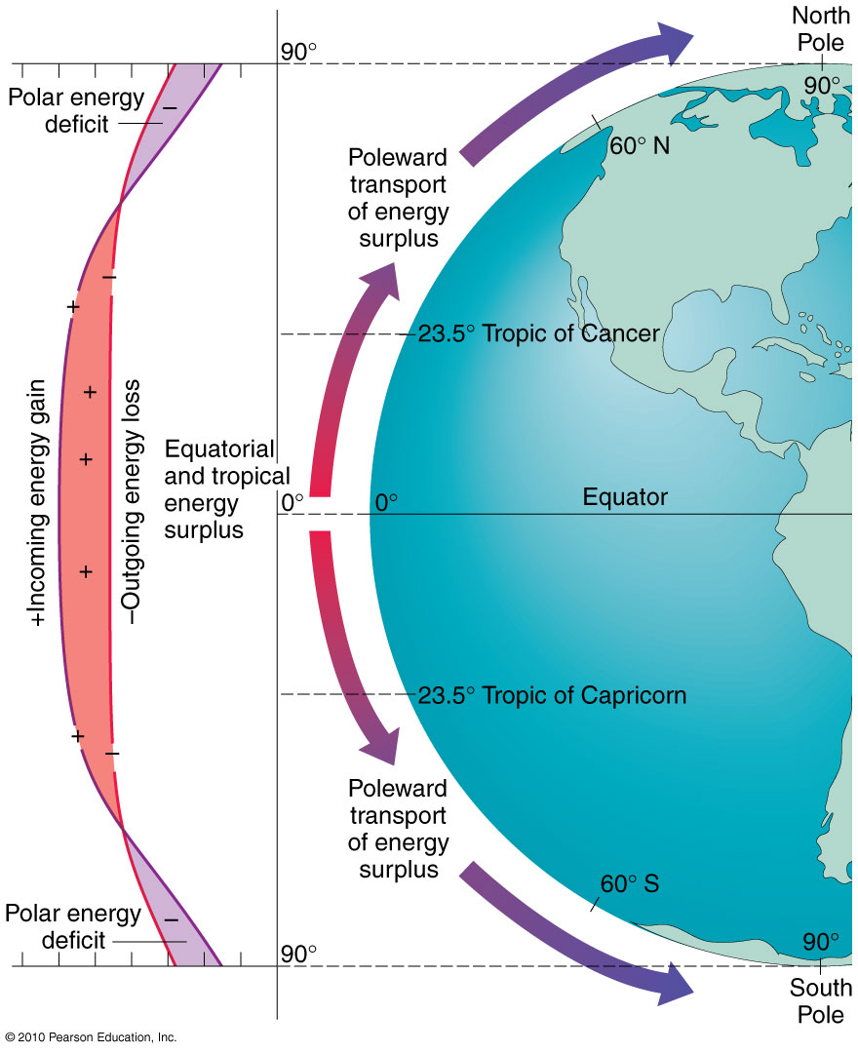
Energy Budget by Latitude NOTE: Tropical surpluses & polar deficits
This drives a vast global
circulation of both energy & mass by winds, oceans & dynamic weather systems
Figure 3.11
Christopherson, Elemental Geosystems, Sixth Edition
Copyright © 2010 Pearson Education, Inc.

Slide 20
Energy at Earth’s Surface
Daily Radiation Patterns
Incoming energy arrives during daylight, beginning at sunrise, peaking at noon and ending at sunset
Within a 24 hour day, air temperature generally peaks between 3:00 and 4:00pm and dip to its lowest point slightly before sunrise
The relationship between the insolation curve and air temperature curve do not align – there is a lag.
The warmest time of day does not occur at the peak of maximum insolation but at the moment when maximum insolation is absorbed and re-emitted to the atmosphere from the ground.

Slide 21
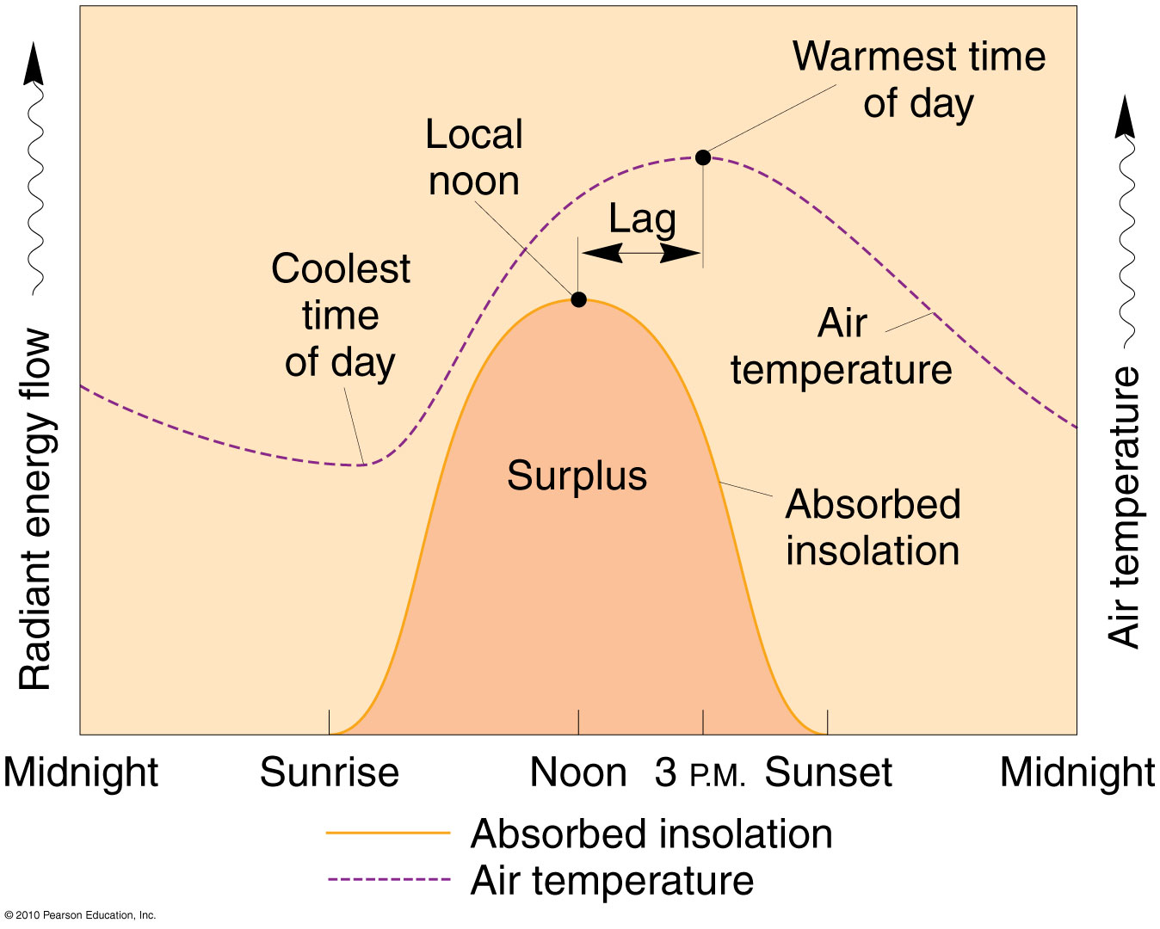
Daily Radiation Patterns
Figure 3.12
Christopherson, Elemental Geosystems, Sixth Edition
Copyright © 2010 Pearson Education, Inc.

Slide 22
Energy at Earth’s Surface
Daily Radiation Patterns
Direct & diffuse radiation & longwave radiation at ground surface are of special interest to geographers
Simplified Surface Energy Balance
+ SW - SW + LW - LW = NET R

Slide 23
Net radiation
Expended from non vegetated surface through 3 pathways;
Turbulent sensible heat transfer
Sensible heat energy transferred from air to surface; surface to air by conduction & convection
Latent heat of evaporation
Heat energy stored in water vapor as water evaporates. Liquid to gas absorbs heat/gas to ice release heat
Ground heating & cooling
Energy that flows into and out of the ground surface by conduction
Notes:
To prevent hailstorms, silver nitrate in dust form put in atmosphere to lower size hail ball sizes

Slide 24
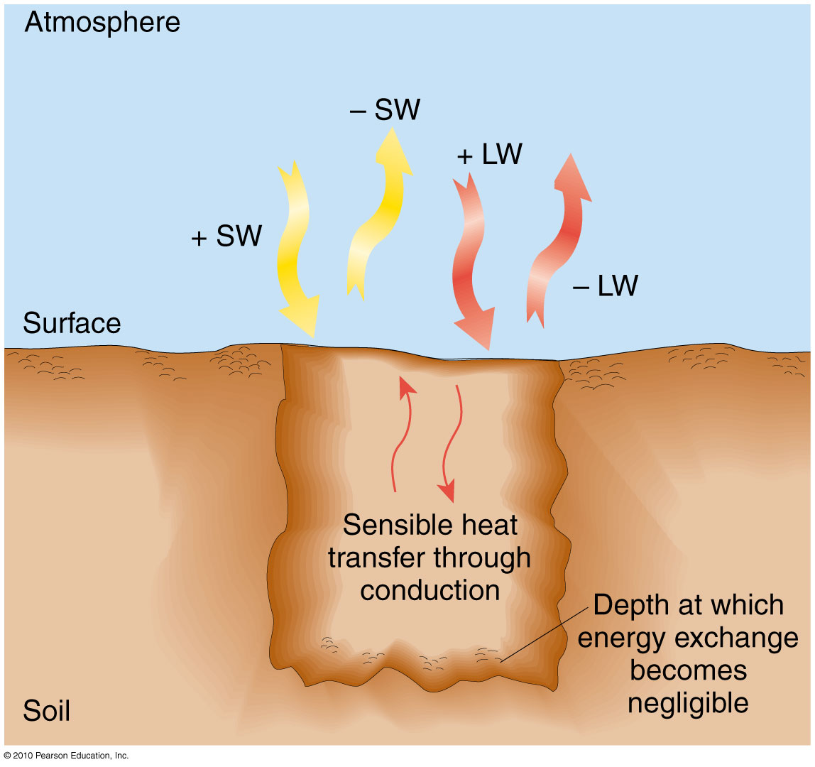
Surface Energy Budget
Figure 3.13
Christopherson, Elemental Geosystems, Sixth Edition
Copyright © 2010 Pearson Education, Inc.

Slide 25
Temperature Concepts and Controls
KEY WORDS:
Heat – form of energy flowing from one system to another
Temperature – a measure of the average kinetic energy of individual molecules in matter
Effect of temperature is felt as sensible heat transfer from warmer to cooler objects
Temperature Scales
Fahrenheit (ºF), Celsius (ºC), Kelvin (K)
Measuring Temperature
Mercury & alcohol thermometers
Principal Temperature Controls
Land–Water Heating Differences

Slide 26
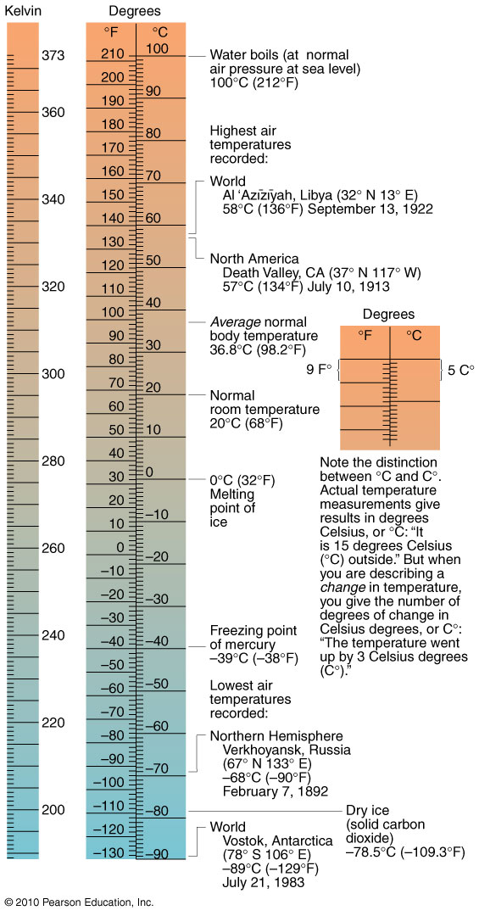
Temperature Scales
Figure 3.15
Christopherson, Elemental Geosystems, Sixth Edition
Copyright © 2010 Pearson Education, Inc.

Slide 27
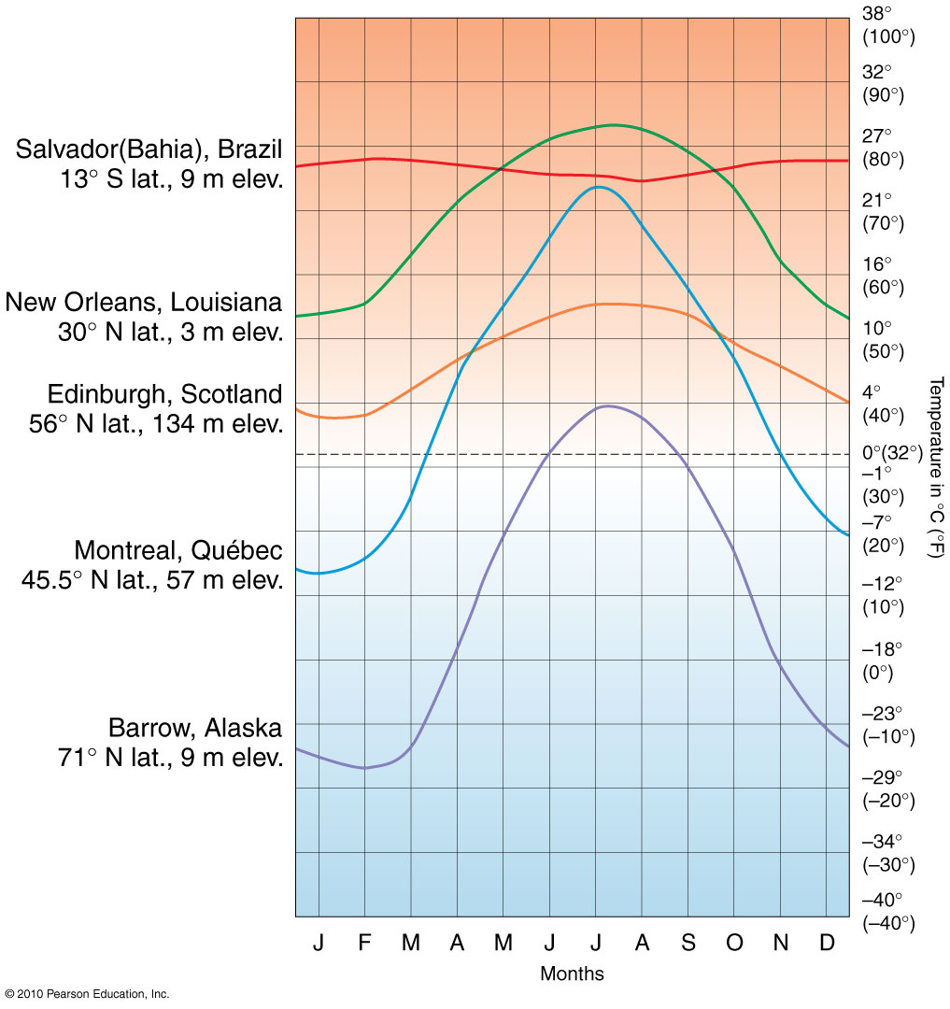
Latitude and Temperature
Figure 3.17
Christopherson, Elemental Geosystems, Sixth Edition
Copyright © 2010 Pearson Education, Inc.

Slide 28
Principal Temperature Controls
The following are the principal influences on Earth’s Temperature patterns
Latitude
Insolation the single most important influence on temp. variations
Insolation intensity decreases as we move away from the subsolar point; day length & sun angle change
Altitude/Elevation
Recall normal lapse rate within the troposphere
Cloud Cover
50% of Earth cloud covered at any time (equator)
Land-Water heating differences

Slide 29
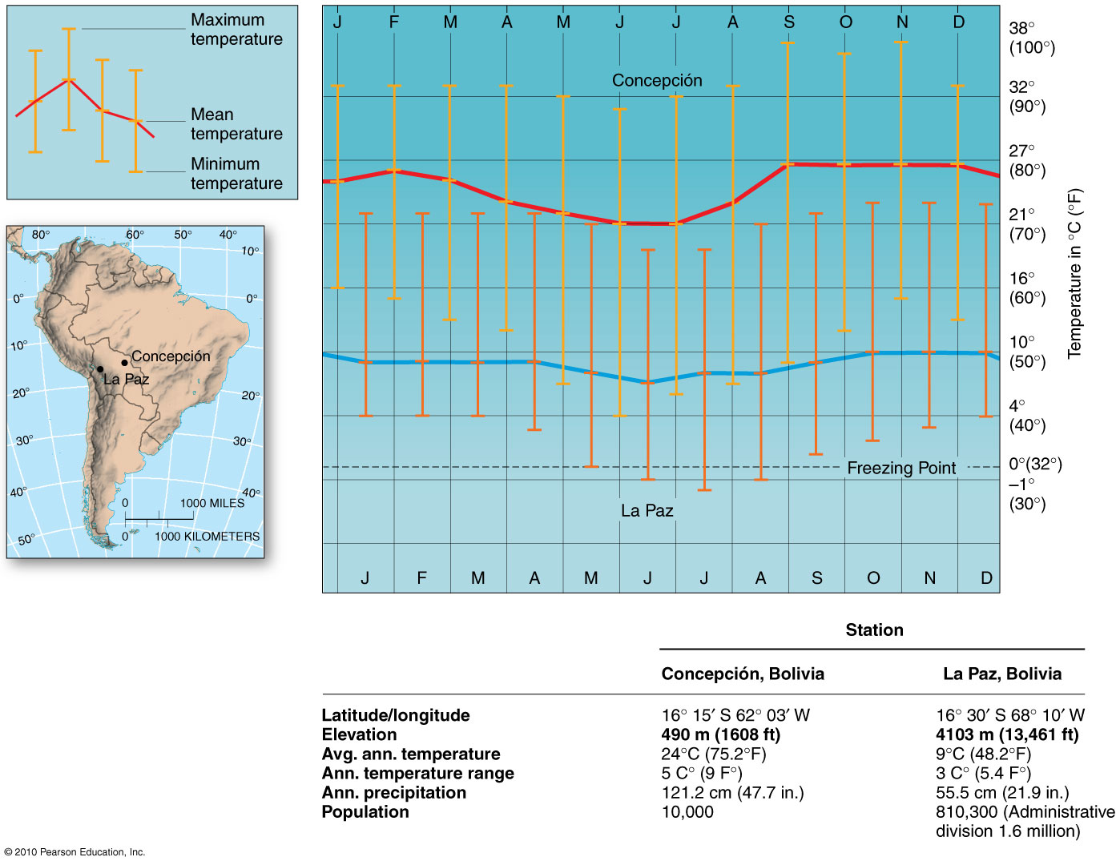
Combined effects of latitude & Elevation
Two cities in Bolivia,
similar latitudes
Figure 3.18
Christopherson, Elemental Geosystems, Sixth Edition
Copyright © 2010 Pearson Education, Inc.

Slide 30
Cloud cover
50% Earth is covered by clouds at any given moment
Moderate temperature
Lower daily maximum temperatures
Raise nighttime minimum temperatures
Acts as as insulator, & re-radiating long wave energy preventing rapid energy loss
Reduce latitudinal and seasonal temperature differences

Slide 31
Land–Water Heating Differences
The arrangement of landmasses and water bodies on Earth contributes to the overall pattern of temperature.
Rock & soil vs. water
Evaporation
Approx. 86% of all evaporation on Earth is from the oceans ~ cooling effect – heat energy is absorbed and stored in the water vapor
Transparency
Soil ~ solid ground opaque – absorb heat
Water ~ transparent ~ light penetrates to an average depth of 60m – called the photic zone (can reach to depths of 300m in the oceans
Specific heat capacity
Water absorbs/needs more heat than soil or rock
Land heats up faster than water
Movement
Water capable of movement – cooler and warmer waters; mixing spreads the available heat over an even greater area

Slide 32
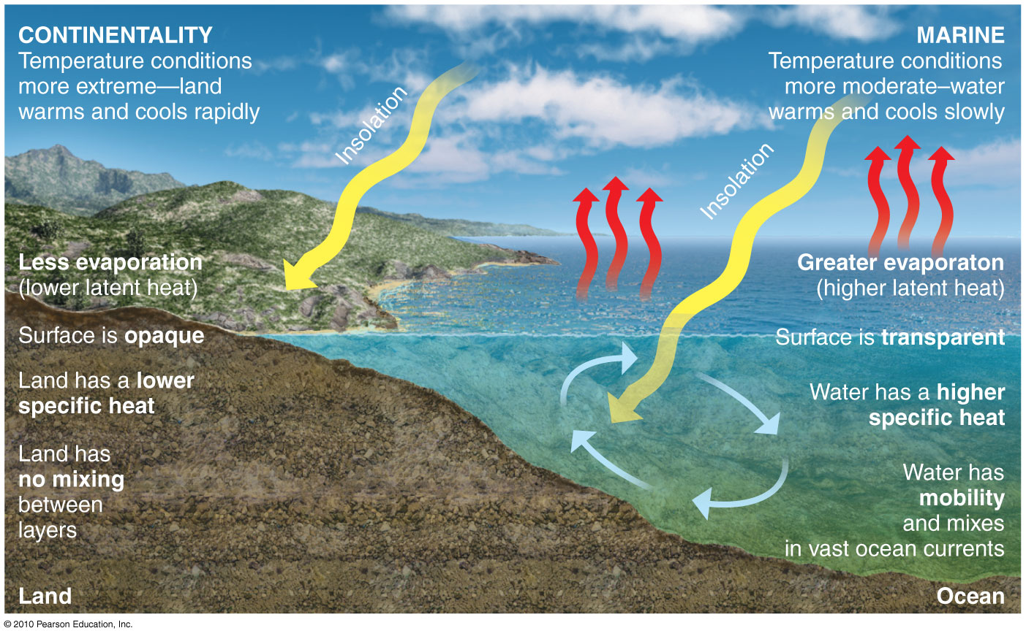
Land–Water Heating Differences
Figure 3.20
Christopherson, Elemental Geosystems, Sixth Edition
Copyright © 2010 Pearson Education, Inc.

Slide 33
Land–Water Heating Differences
Ocean Currents and Sea-Surface Temperatures
Ocean currents have an influence on temperature and weather
Warm water has the capacity to energize overlying air through high evaporation rates and transfers of latent heat
Think of the formation of hurricanes in the warm Atlantic Ocean during the summer
Gulf Stream – in the Atlantic Ocean carries warm water far into the North Atlantic

Slide 34
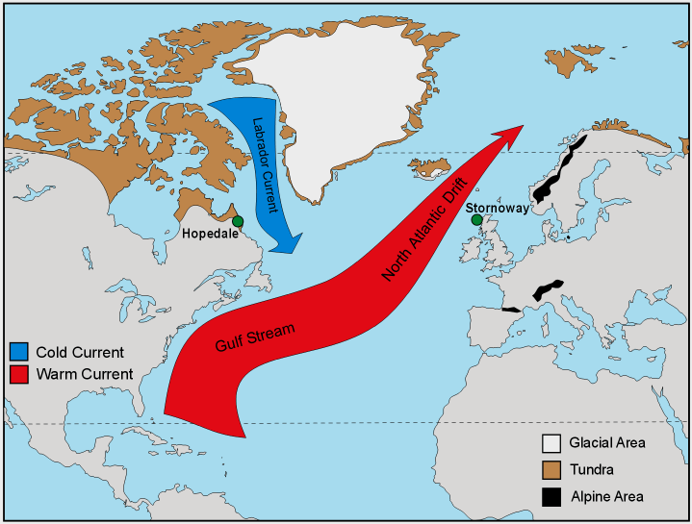
Ocean Currents and Sea surface Temperatures

Slide 35
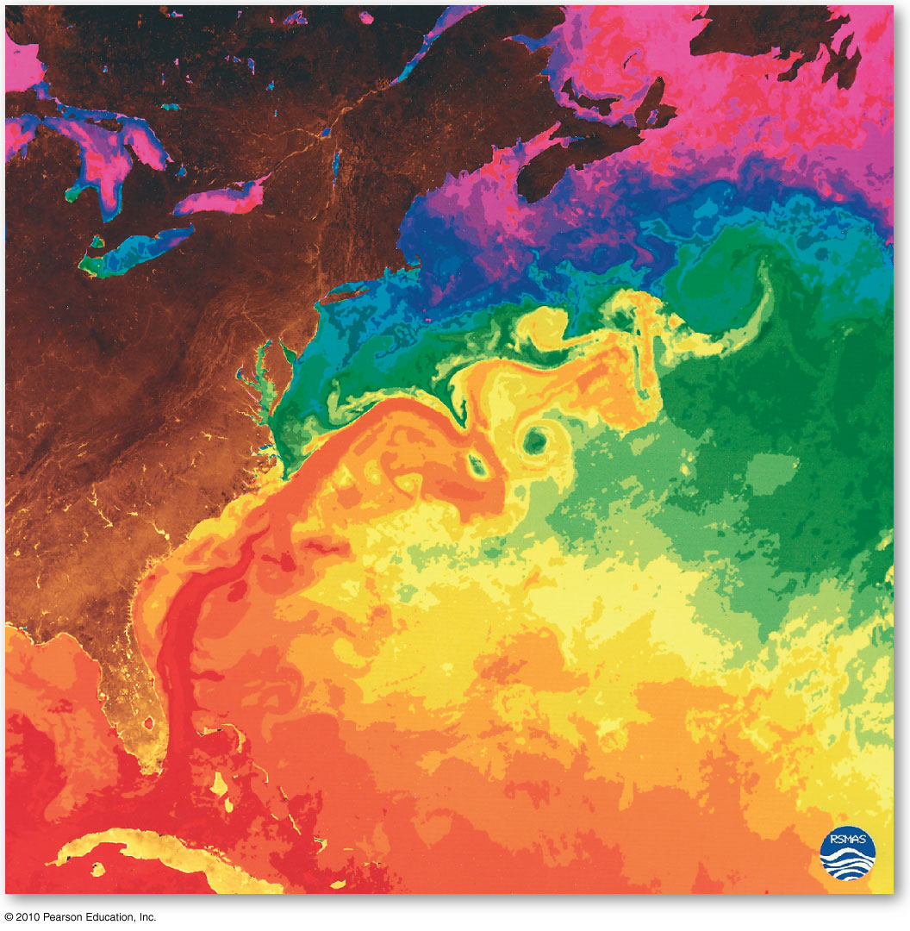
The Gulf Stream
Reds/oranges
25º – 29ºC
Yellows/greens
17º – 24ºC
Blues
10º – 16ºC
Purples
2º – 9ºC
Satellite image
Instruments sensitive to long wave
radiation produced this remote sensing image
Figure 3.21
Christopherson, Elemental Geosystems, Sixth Edition
Copyright © 2010 Pearson Education, Inc.

Slide 36
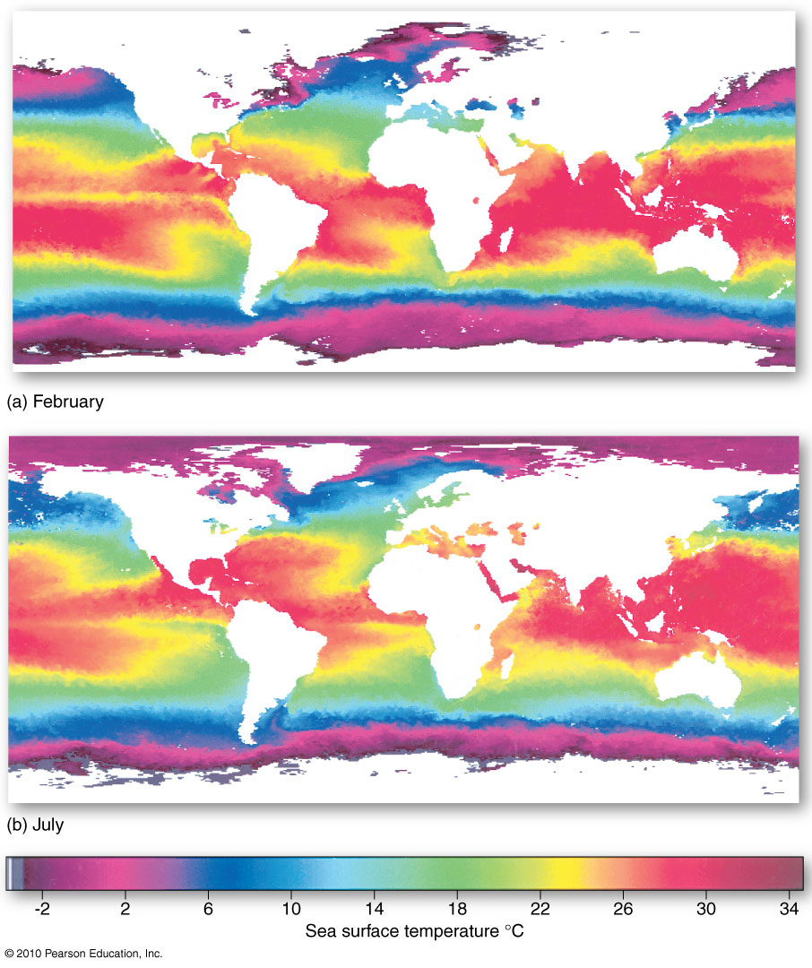
Sea-Surface Temperatures
Average annual
sea-surface temperatures for February and July
1999
Figure 3.22
Christopherson, Elemental Geosystems, Sixth Edition
Copyright © 2010 Pearson Education, Inc.

Slide 37
Land–Water Heating Differences
Summary of Marine Effects Versus Continental Effects
Marine effects or maritime – describe locations that exhibit the moderating influences of the ocean or large bodies of water
Continental effect or continentality – describe areas that are less affected by seas or lakes
Experience greater range between maximum and minimum temperatures diurnally and seasonally

Slide 38
Land–Water Heating Differences
Figure 3.20
Christopherson, Elemental Geosystems, Sixth Edition
Copyright © 2010 Pearson Education, Inc.

Slide 39
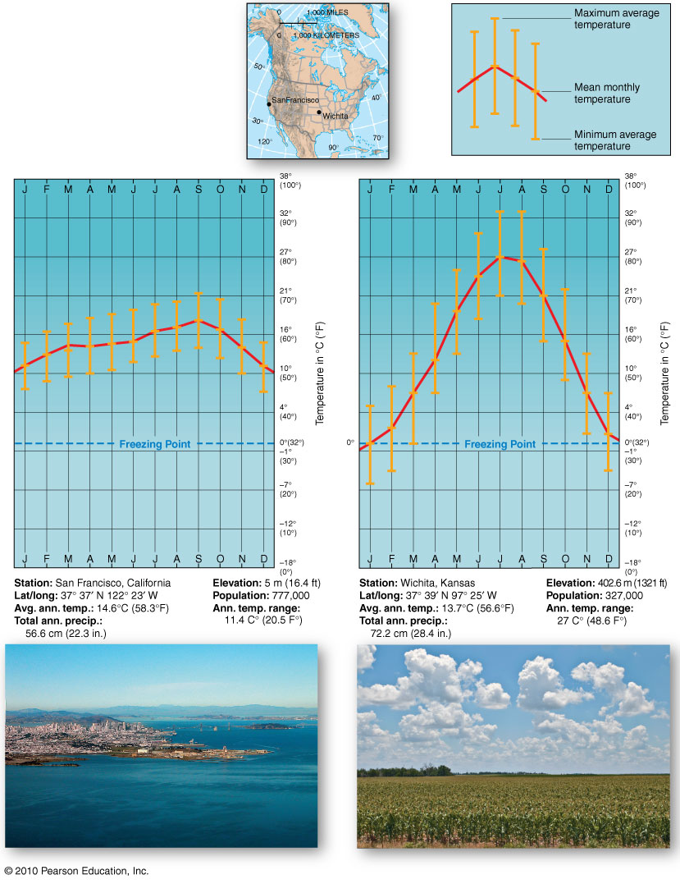
Marine (San Francisco California) & Continental (Wichita, Kansas) Climates
Figure 3.23
Christopherson, Elemental Geosystems, Sixth Edition
Copyright © 2010 Pearson Education, Inc.

Slide 40
Earth’s Temperature Patterns
Looking at the combined effects of the controls on Earth’s Temperature
This is done by looking at temperature maps
They show mean monthly air temperatures for January and July
Annual temperature ranges of January and July
Useful in identifying areas that experience the greatest annual extremes
Lines on temperature maps are called isotherms
Thermal equator - a line connecting all points of highest mean temperature
Air temperature on people: summer heat-wave deaths during the last 10 years in Canada, U.S and Europe; unusually cold winter in England/Scotland last year

Slide 41
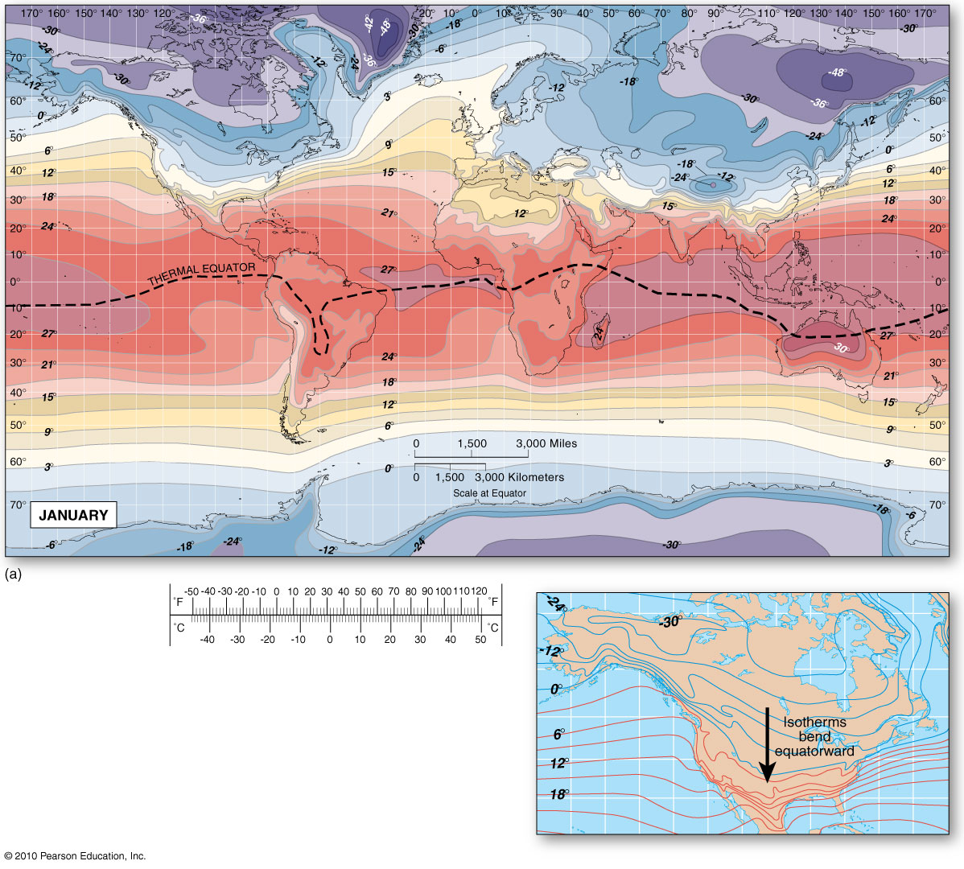
Global temperatures for January
Note the equatorward-trending
isotherms in the interior of NA –
Continentality vs Marine effects
Figure 3.24
Christopherson, Elemental Geosystems, Sixth Edition
Copyright © 2010 Pearson Education, Inc.

Slide 42
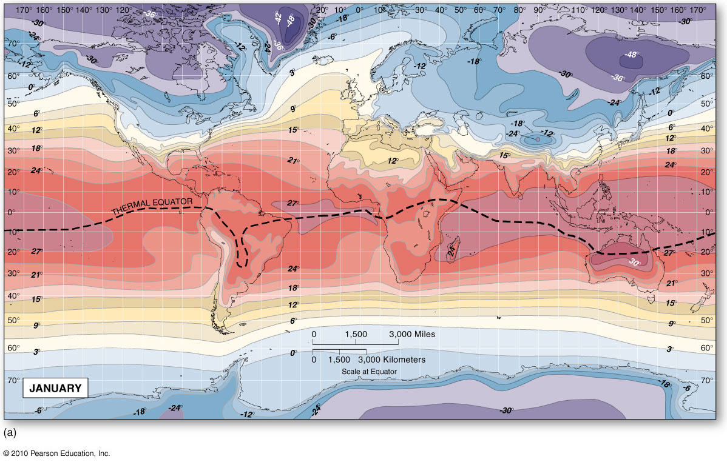
January Temperatures
NH – isotherm trend equator-wards – chilling of continental interior
Oceans show more moderate temperatures
Note mountain ranges – cooling effect of elevation
Figure 3.24
Christopherson, Elemental Geosystems, Sixth Edition
Copyright © 2010 Pearson Education, Inc.

Slide 43
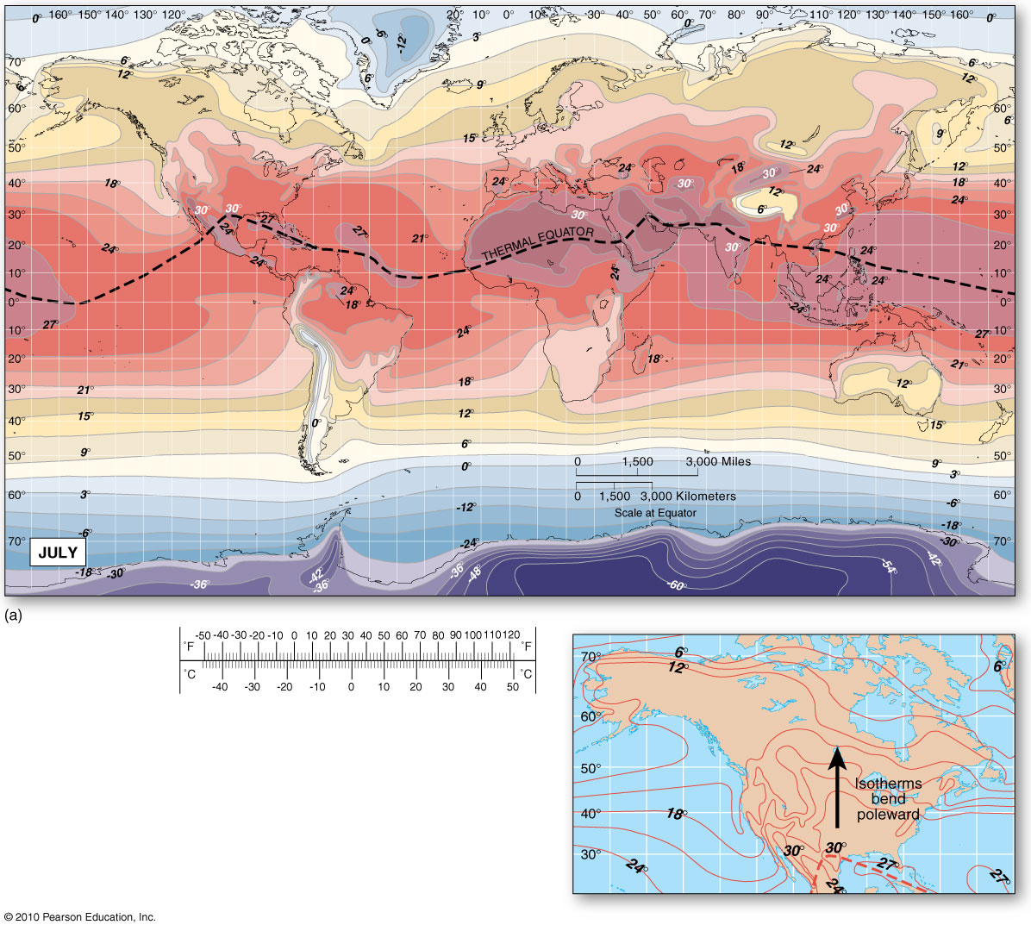
July Temperature Map
Longer days of summer & higher sun altitude
in the NH –
Thermal equator shifts northward ~ higher
temperatures dominate continental interiors
Figure 3.27
Christopherson, Elemental Geosystems, Sixth Edition
Copyright © 2010 Pearson Education, Inc.
Notes:
The sun is (winter solstice) at tropic of capricorn or (summer) tropic of cancer

Slide 44
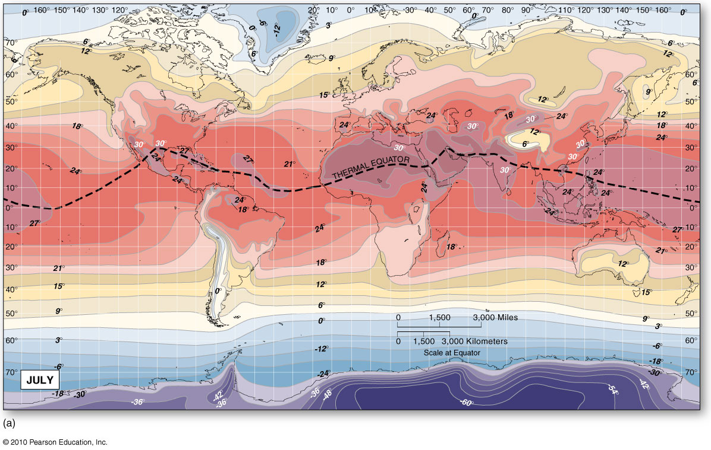
Global Temperatures for July
Note: Marine effects vs. continental effects
Figure 3.27
Christopherson, Elemental Geosystems, Sixth Edition
Copyright © 2010 Pearson Education, Inc.

Slide 45
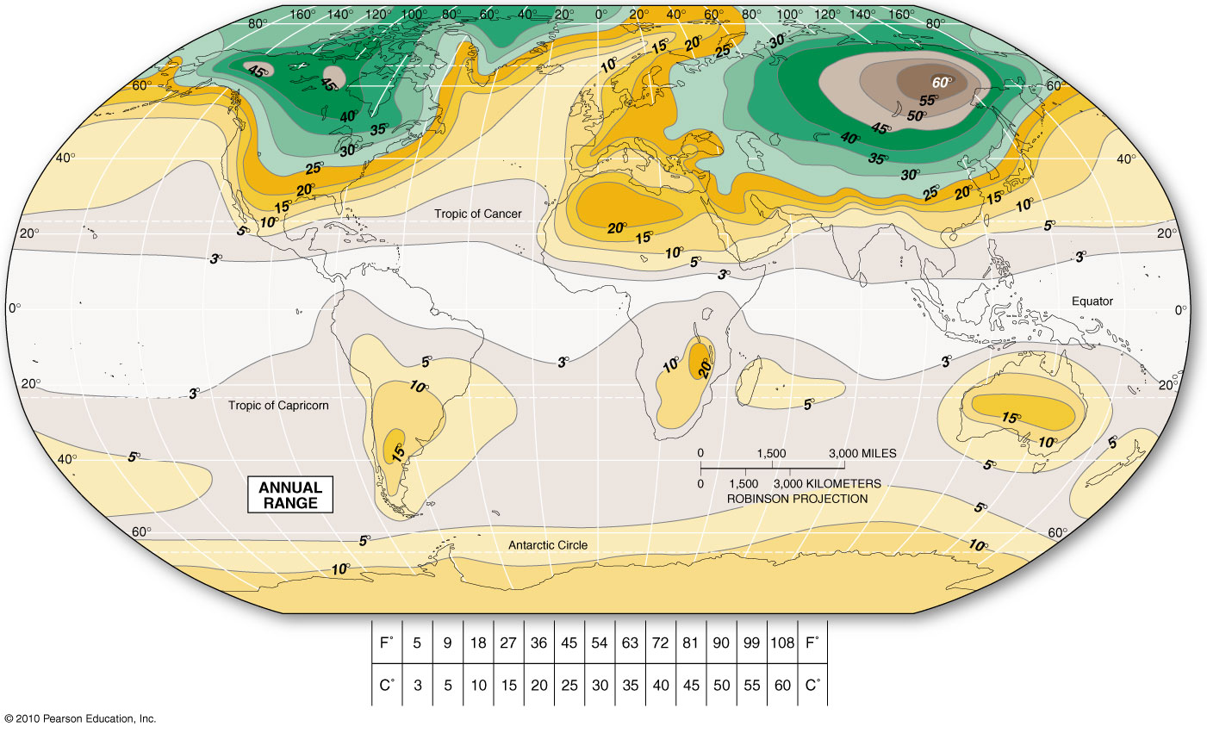
Global Annual Temperature Ranges
Largest temp. ranges are observed in subpolar locations in NA & Asia
Figure 3.29
Christopherson, Elemental Geosystems, Sixth Edition
Copyright © 2010 Pearson Education, Inc.

Slide 46
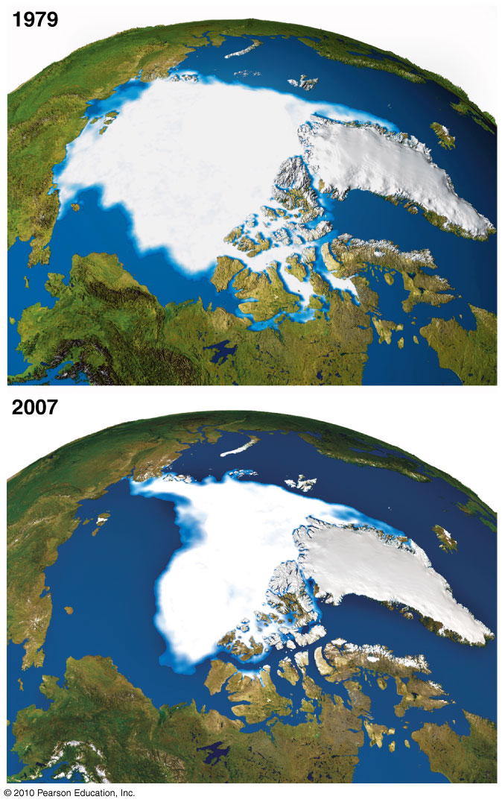
Loss of Arctic Sea Ice
Climate models are showing
that Polar regions are
experiencing dramatic global
climate change impacts
Composite of satellite data &
surface data
Figure FS 3.1.1
Christopherson, Elemental Geosystems, Sixth Edition
Copyright © 2010 Pearson Education, Inc.

Slide 47
The urban Environment
Urban microclimates
In cities the temperatures experienced each day are affected by the urban landscape
Similar to desert locations
Because more than 50 % of the Earth’s population live in cities today – specific environmental effects related to cities are of great importance ~ urban microclimatology
Urban heat island
On average both max. and min. temperatures are higher in urban areas vs. rural areas
Dust dome

Slide 48
The Urban Environment
Average differences in Climactic Elements of Urban compared with Rural environments
Contaminants – 10 times more in urban areas
Radiation - less
Cloudiness- more
Precipitation – snowfall less in the inner city; thunderstorms more
Temperature – winter minima more; summer maxima more
Relative Humidity – less over urban areas
Wind Speed - less

Slide 49
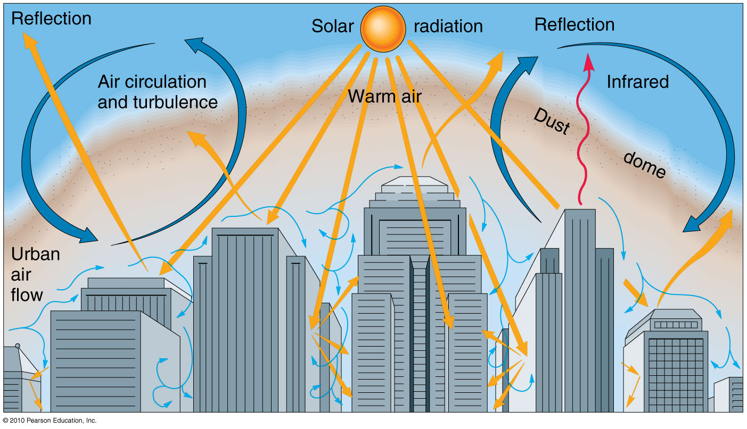
The Urban Environment
Figure 3.30

Slide 50
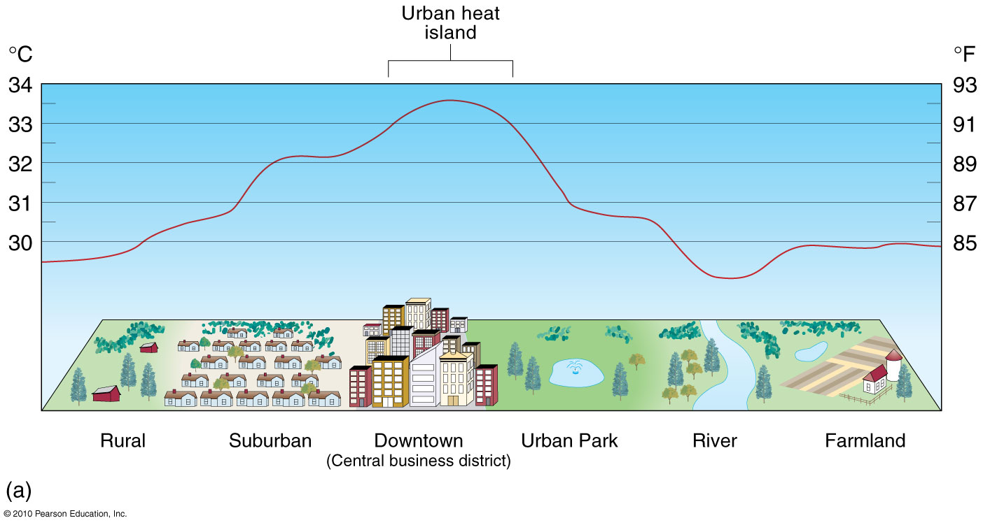
Urban Heat Island
Figure 3.31a

Slide 51
End of Chapter 3
Next lecture Chapter 4
Atmospheric and oceanic Circulations

